Slide 1
Media Access Control in Ad Hoc Networks
The Wireless Medium is a scarce precious resource.
Furthermore, the access medium is broadcast in nature.
It is necessary to share this resource efficiently and effectively in a fair manner among the various nodes that require this resource.

Slide 2
What are the possible ways ?
Fixed Allocation
TDMA, FDMA – allocate a share of the available bandwidth permanently to users.
Will soon run out of bandwidth – not scalable.
Dynamic Allocation – Reservations
Difficult to do in a distributed setting.
Synchronization between nodes is extremely difficult.
Random Access Methods
Popular ones used in networks – Aloha, CSMA-CD.
Carrier Sensing does not help as much.
Does not yield high throughput.
Token Passing is not an option – really ☺!

Slide 3
Physical Channel
The wireless channel is harsh. Three kinds of effects that usually occur:
Attenuation due to path-loss
As radio transmission goes over a distance r, it is attenuated as 1/r⁴. (The exponent could be different in different scenarios, but this is usually used.
Shadowing
Due to the presence of hills, other large objects. Usually lognormal.
Multi-path Fading
Due to the multi-path nature of channel.

Slide 4

Multi-Path Effects
Could cause a significant attenuation due to the destructive combination of signals.
Usually rate dependent.
For narrowband it causes what is called as “non-frequency selective fading – wipes out certain frequencies totally.
Usually follows a Rayleigh or Ricean distribution.
For broadband transmission causes spreading of signals – overlay of delayed signals – causes what is called as Inter Symbol Interference.

Slide 5
Some Key Concepts
COLLISIONS: When two or more transmissions are received at the same time, it is said that there is a collision at the receiver (Note that the two transmissions ought to be with the same frequency and at the same time.).
CAPTURE: If the signal strength of one of the signals is sufficiently larger than that of an other, this signal could potentially be captured at the receiver. The other signal is called “INTERFERENCE”.
CARRIER: Usually there is a high frequency carrier upon which the data is super-imposed (MODULATION).
For the purposes of this discussion we ignore capture and interference – only collisions.

Slide 6
CSMA – Carrier Sense Multiple Access
Every node senses the channel before initiating a transmission.
If it senses a carrier it defers transmission.
If it senses a busy channel, it backs-off in accordance to the exponential back-off scheme.
CSMA is popular – in many architectures such as in Ethernet.
Ability to detect collisions – CSMA CA.
However, in Wireless LANs and Ad hoc Networks this does not work very well.
Collision happens at receiver not transmitter ☹ !

Slide 7
Hidden and Exposed Terminals
A wants to transmit to B.
C senses channel – no idea A is transmitting.
C initiates transmission to F.
Collision at B. – C and A are hidden from each other.
A
B
F
C
D
E
D could potentially transmit to E but does not – senses A’s carrier. D is exposed to A. Loss in throughput.

Slide 8
MACA : Multiple Access with Collision Avoidance
RTS
A
B
CTS
D
C
Exchange of two short messages – Request to Send (RTS), and Clear to Send (CTS).
They are fixed size – when A wishes to transmit to B, it sends an RTS message.
RTS message contains duration of proposed transmission
If B knows that the channel is free, it responds with a CTS message. (CTS also contains duration of proposed communication)
How does this help ?

Slide 9
RTS
A
B
CTS
D
C
Any station that hears the RTS message, defers all communication for some time until the associated CTS message has been finished.
A CTS message defers communication for the duration of the time indicated in the CTS message.
When A is transmitting data, C can go ahead and access the channel.

Slide 10
Some effects in MACA
Node B’s CTS message may not be heard by A.
B found that the channel was already busy.
RTS packet might collide.
If A does not receive a CTS, it times-out and schedules the packet for retransmission.
MACA uses the binary exponential back-off algorithm to select the retransmission time.
B’s CTS message collides at C.
This would cause C to be unaware of the pending communication between nodes A and B.
NOTE: MACA is used (with Modifications) in the WaveLAN cards.

Slide 11
Details of Exponential Back-Off, etc.
RTS and CTS slot times (defined to be 30 bytes) form the basic slot size.
If CTS is not heard, a station chooses a time that is uniformly distributed between 1 and BO (for Back-Off). What is BO ?
If a CTS message is received then BO is set to BO_{min} .
If a CTS is missed, then, if the previous BO was BO_{old}, the new BO, BO_{new} is set to BO_{new} = Min ( 2 x BO_{old}, BO_{min}).
BO_{min} and BO_{max} represent the minimum and maximum back-off intervals.

Slide 12
Reference
P. Karn, “MACA – A new channel access method for Packet Radio,” ARRL/CRRL/Amateur Radio 9th Computer Networking Conference, September 1990.
Notice that this was primarily meant for packet radio networks – relatively stationary. Mobility causes problems to some extent.

Slide 13
Design Criteria
The MAC protocol should yield the best possible network utilization.
Yet, it should be fair – it should not be the case wherein one node could dominate the channel access and other nodes be starved.
These are in some sense contradicting features.
Studies by Bharghavan (UIUC) et al, lead to certain observations with regards to the features of MACA.

Slide 14
Unfairness due to Binary Exponential Back-Off
Let us consider two nodes contending for channel bandwidth in some vicinity e.g. D → A and B → A.
If both B → A and D →A require long term data transfer and both B and D are heavily loaded, then the one that starts earlier captures the channel.
The other backs-off more and more.
Similarly if one is heavily loaded say B → A and the other is not, B →A gets exclusive use until B is done. Again because D backs off more and more.
A
B
D
E
Less Backed-Off Node Wins

Slide 15
MACAW Modification
Include in packet header, the value of the back-off counter.
Thus, whenever a node hears the packet, it copies the value indicated into its own back-off counter.
Thus, each node in the range of the transmitting node has the same back-off counter.
Really designed for Wireless LANs.
Does not eliminate the problem here. Can you think why ?

Slide 16
MACAW also proposes to make the back-off more gentle !
The current scheme results in widely fluctuating oscillations.
Thus, decrease by one at the receipt of a CTS rather than starting all over with BO_{min}.
Also, instead of doubling the time-out when a CTS is missed, change it to such that
BO_{new} = Min(1.5 BO_{old,} BO_{max}).
This helps in reducing number of fluctuations.
They call this the “MILD” model.

Slide 17
Reliability in MACA
Mobility (or fading) causes packets to be corrupted or lost.
How is reliability ensured ?
One could have reliability at the link level or end-to-end.
In MACA, no concept of reliability at link level.
If due to some reason packet is lost, MACA relies on a higher layer (TCP) to make the recovery.
Link level recovery is good if the links are not that stable – wireless.
In MACAW, an additional ACK message is included to provide link layer reliability.

Slide 18
Reliability in MACAW
The authors amend the RTS-CTS exchange to include a fourth message which they call the ACK message.
This provides some reliability – example if CTS message collides at C and it initiates a message at the same time as A does to B, then the data never reaches B.
Note: Everything is asynchronous here.
If ACK is not received due to data loss, reschedule retransmission.
If data was indeed received and ACK lost, when RTS is sent for retransmission, reply with ACK.
A
B
F
C
D
E
Back-off upon discovery of loss.

Slide 19
How does this change effect ?
We said that while A → B, D could perform D → E.
Ok in MACA – Exposed Terminal problem resolved ?
Now, since DATA/ACK exchange occurs, CTS message from E could collide with a transmission from A (retransmissions allowed !).
This results in increase in D’s back-off counter: more problems.
Note that now, congestion occurs at both transmitter and receiver.
D has to defer transmission while A → B is happening.
But what if CTS is lost ?
D has to sense for A’s carrier
A
B
F
C
D
E
MACAW proposes a special,short DS (Data Sending) packet prior to data transmission.

Slide 20
Need for some synchronization
Let us look at two contending flows:
A
B
C
D
If they are heavily loaded flows, one flow C → D may totally get the channel bandwidth.
B does not respond since it has heard C’s CTS message.
Now, unless A transmits an RTS in the small gap between the communications between D and C, it can never get the channel. Note data transfer takes a relatively long time.
Furthermore, this would result in A backing off a lot.
Lack of synchronization between when communication between D and C pauses.
The magic RRTS message.

Slide 21
The RRTS Message
A
B
C
D
Note – B knows when the gaps occur, although A does not.
So why not B take an aggressive role ?
B sends a RRTS – Request for Request to Send Message to A.
A responds with RTS and communications continue.
Stations overhearing RRTS (In our case C) defer transmissions for two slot periods – enough for an RTS CTS exchange.
Does this solve all problems ?

Slide 22
A
B
C
D
Unfortunately, the answer is NO ☹.
Look at the above wherein C → D instead of vice versa.
In this case C → D dominates the channel.
A’s RTS arrives during data transfer from C to D in most cases and cannot even be heard by B ..... unless it arrives in a gap during communication.
The RRTS message does not help here !

Slide 23
Multicast or Broadcast
Much more difficult.
What do we do, we want multiple people to receive the packet upon broadcast.
Unreliable is one option – akin to Aloha.
We could use CSMA.
MACAW suggests that we use an RTS immediately followed by data – at least receivers in range will defer transmissions noting that this is a multicast (as indicated in RTS).
However, same flaws as CSMA.
Open Problem – reliable broadcast/multicast.

Slide 24
Other problems with back-off
B
C
A
D
A’s back-off timer is copied by B, which is copied by C, which is in turn copied by D. The propagation is not good ☹!
CTS failures may not be due to congestion; could be due to fading.

Slide 25
Reference
Bhargavan, V., Demers, A., Shenker, S. and Zhang, L., “MACAW: A media access protocol for wireless LANs”, Proceedings of ACM SIGCOMM ’94, pp. 212-25, ACM, 1994
Note that this paper has been written with Wireless LANs in mind.. but many concepts are applicable to ad hoc networks – so keep that in your mind when you read the paper.

Slide 26
The IEEE 802.11 Protocol
The IEEE 802.11 MAC protocol derives from MACA [1] and MACAW [2].
It uses both a physical and a virtual carrier sense mechanism.
It uses an RTS-CTS-DATA-ACK dialogue to accomplish data transmission.
Each message in the dialogue contains duration information for the remainder of the dialogue.

Slide 27
The IEEE 802.11 MAC layer
The Distributed Coordination Function (DCF): Fundamental, contention-based access method. Implemented for use with both ad hoc and infrastructure networks.
The Point Coordination Function (PCF): Optional, contention-free access method usable only on infrastructure networks.
DCF utilizes an RTS-CTS exchange to reserve the channel prior to DATA transmission. Successful DATA transmission is followed by an ACK from the recipient.
PCF requires one node to function as a polling master. This node is called the point coordinator (PC).

Slide 28
The DCF Carrier Sensing
Virtual carrier sense implemented using a network allocation vector (NAV).
The NAV at each node is set to indicate the remaining time before the medium is expected to become idle.
The NAV is updated based on duration information contained in overheard messages.
Actual carrier sense combines the NAV state, the node’s transmission status and the physical carrier sense indication from the physical layer.

Slide 29
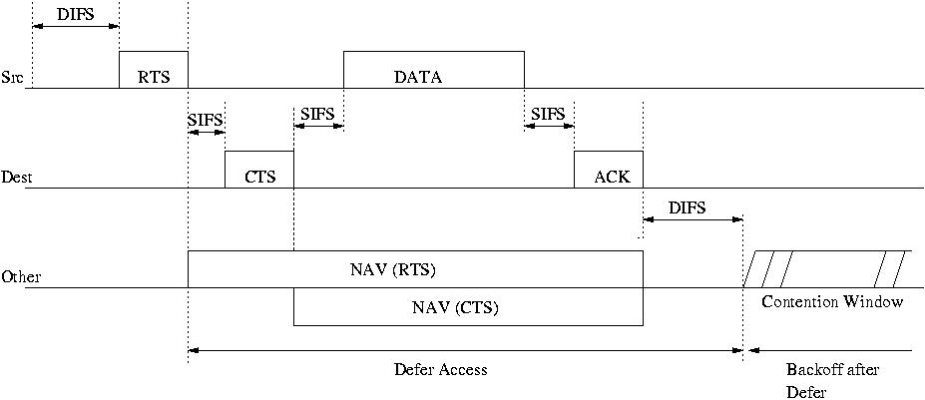
Basic Medium Access under the DCF

Slide 30
Medium Access Issues in Heterogeneous Networks
The existing medium access schemes typically assume homogeneous power capabilities, i.e. all nodes transmit at the same power level.
The rapid spread of multifarious wireless network enabled devices jeopardizes this assumption.
It is important to investigate if the MAC protocol in use unduly favors devices that can transmit at higher power levels.

Slide 31
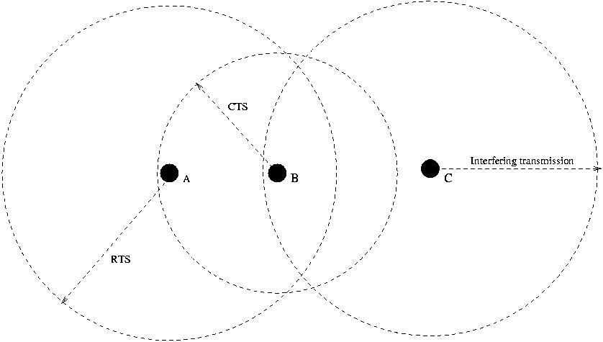
Failure of RTS/CTS in Heterogeneous Network

Slide 32
Effects of range heterogeneity
Significant degradation in throughput.
One way of overcoming this is to flood (remember flooding ☺ ?) the CTS message within certain distance of the transmission.
However, this does not help. Why ?
A lot more messages – create more collisions and therefore a further degradation in throughput.
Need for a more intelligent way of dissemination of control messages.

Slide 33
Reference
·Poojary, N., Krishnamurthy, S.V. and Dao, S, Medium Access Control in a Network of Ad Hoc Nodes with Heterogeneous Transmit Power Capabilities, Proceedings of ICC 2001.
On my web site.

